Slide 1
About Viruses Hacking, Viruses and malicious and software
I need to pre-empt this by stating that I worked for Apple as senior software trainer and favour Apple Macs over other computers.
I do not go anywhere near Social networks so I avoid most malicious attempts to invade my computer.
Given here is my thoughts and opinions and may not be the opinion of others and any advice given should be left to your own decision.
The GENERAL RULE IS if it looks suspicious or if
the offer is to good then it is probably a scam,
delete it or ignore it.
Contact the provider by phone and ask them directly.
Peter Faulks About Computer Viruses and Hacking Slide 1

Slide 2
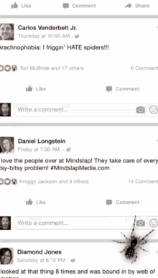
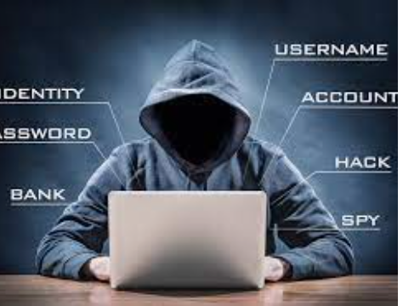
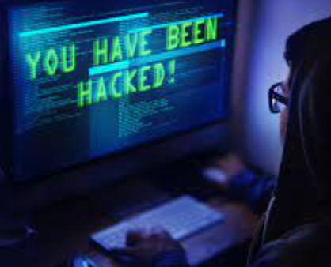
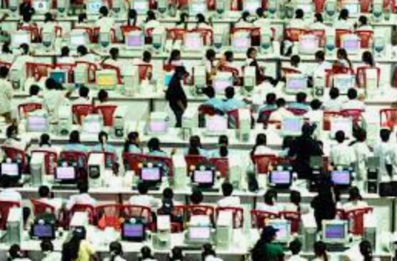
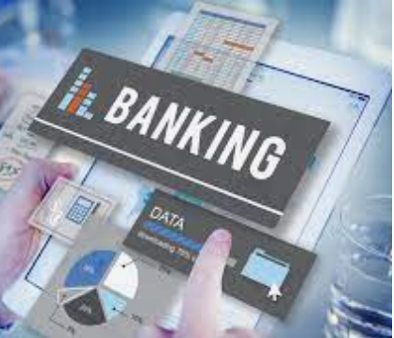
About Viruses and malicious and software
Table of Contents
Adware
Bot Net. Distributed denial of service (DDoS) attacks
Data breach
Emotet
Hacker
Keylogger
Malware
Phishing (Spear, Whaling, Vishing, Email Phishing)
Ransomware
Spam
Spyware
SQL injection
Trojan
Worms
Hackers working somewhere
Peter Faulks About Computer Viruses and Hacking Slide 2

Slide 3
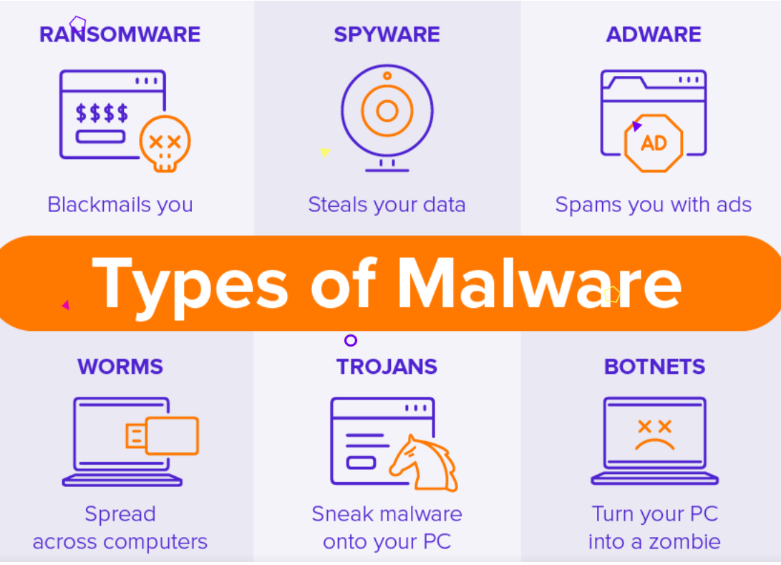
Adware - short for advertising supported software browser hijackers
Adware’s job is to create revenue for the developer by subjecting the victim to unwanted advertisements. Common types of adware include free games or browser toolbars. They collect personal data about the victim, then use it to personalize the ads they display. Though most adware is legally installed, it’s certainly no less annoying than other types of malware.
You go online with your nice, well-behaved browser, only to see it fly into a virtual tantrum, as an onslaught of advertisements either pops up, slides in from the side, or otherwise inserts itself to interrupt and even redirect your intended activity. And no matter how much you click to close those windows, they keep buzzing you like flies at a picnic.
Removing Adware
Download a legitimate cybersecurity program such as Malwarebytes for Windows, Malwarebytes for Mac, Malwarebytes for Android, Malwarebytes for Chromebook, and Malwarebytes for iOS. All are free to try, and are designed to search and destroy adware, PUPs, and any new forms of malware lurking on the scene. Run a scan and, if there are any nasties hiding away in your machine, it’ll bag, tag, and dump them for you. At this point, it’s a good idea to change your password, not only for your PC, but also your email, your social media accounts, your favorite shopping sites, and your online billing centers.
https://www.malwarebytes.com/adware
Peter Faulks About Computer Viruses and Hacking Slide 3

Slide 4
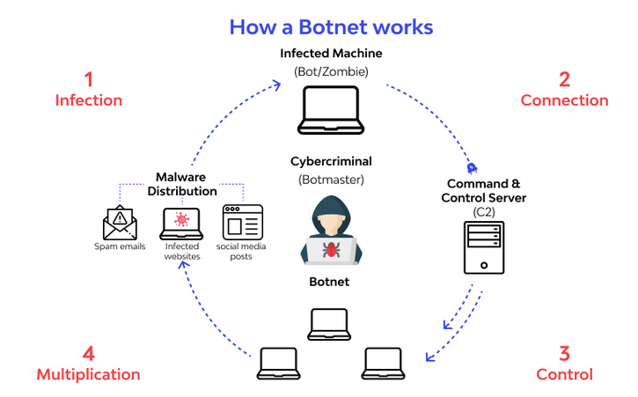
Bot Nets & Denial of Service – Your network has been compromised!!!
A botnet (is an autonomous program on the internet or another network that can interact with systems or users on your network.) It isn’t a type of malware, but a network of computers or computer code that can carry out or execute malware. Attackers infect a group of computers with malicious software known as “bots,” which are capable of receiving commands from their controller.
By literal definition, botnet refers to the web of blighted or hijacked computers used for processes like sending spam emails, distributing malware, and framing DDoS attacks. Activation of botnet doesn’t mandate the permission of the device owner.
The corrupted devices involved could be computers, PC, or many other data-driven devices. From another angle, a DDoS attack can look like a traffic jam created intentionally so that desired end-users don’t reach their destinations.
How to help stop or prevent Bot Net attacks
1. Run good quality antivirus
2. Save all your passwords and settings, then Once a week or once a month reset the modem device, and if you think that you have been attacked reset the modem to default setting (usually a pin push hole on the modem) and start over again, but you will need your passwords and current settings and it will take time.
https://www.wallarm.com/what/what-is-a-botnet
Peter Faulks About Computer Viruses and Hacking Slide 4

Slide 5
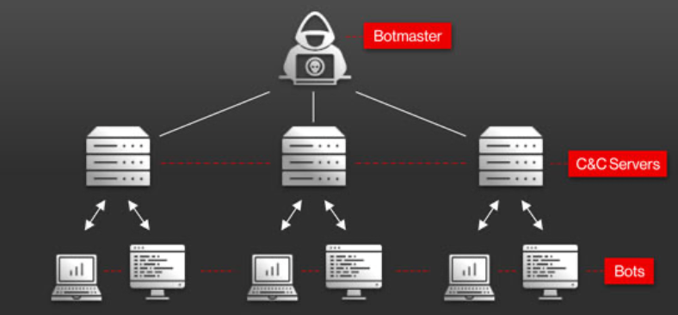
Bot Nets & Denial of Service
Usually found from On-line Gaming
Alone, botnets are not detrimental to the network and can be used for crucial tasks like chatroom management and tracking the points accumulated during online games. The controlling party of the botnet is known as a bot-herder and each individual machine, concerned in the network, is known as a bot.
DDoS or Distributed Denial-of-service attack involves disturbing the customary traffic of a server in a way that actual or intended audiences are not able to access the website. The attack gains its efficacy from using the assorted corrupted systems as the sources of creating disturbing traffic.
Indicators of a DoS attack include:
Slow network performance such as long load times for files or websites
The inability to load a particular website such as your web property
A sudden loss of connectivity across devices on the same network
Peter Faulks About Computer Viruses and Hacking Slide 5

Slide 6
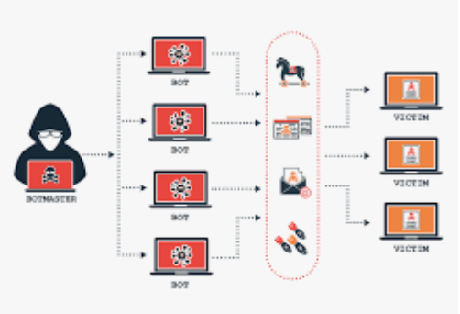
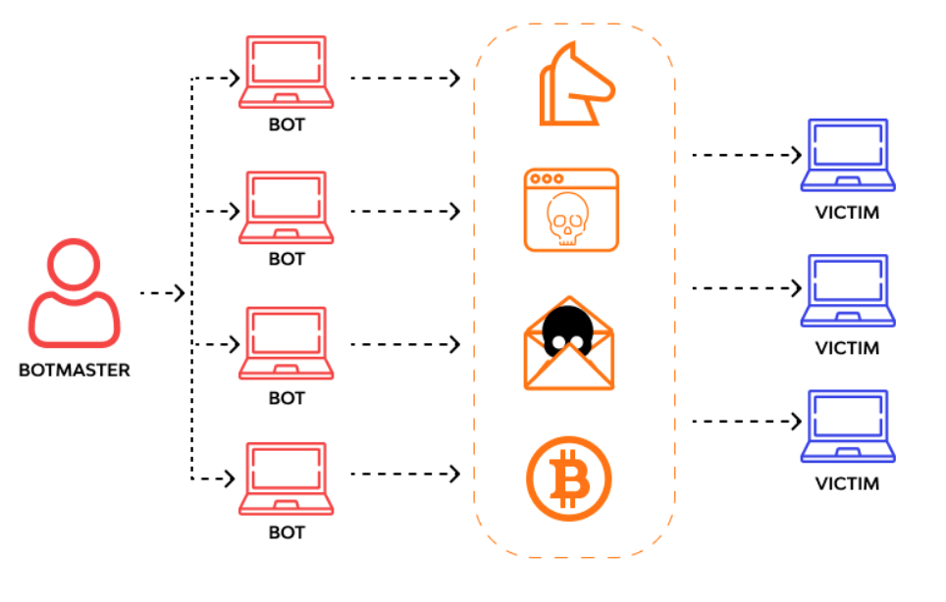
Bot Nets & Denial of Service
These computers then form a network, providing the controller access to a substantial degree of collective processing power, which can be used to coordinate distributed denial of service (DDoS) attacks, send spam, steal data, and create fake ads on your browser.
(DDoS) attack is a malicious attempt to disrupt the normal traffic of a targeted server, service or network by overwhelming the target or its surrounding infrastructure with a flood of Internet traffic.
They oversaturate the capacity of a targeted machine, resulting in denial-of-service to additional requests.
These attacks are carried out to degrade or disable the performance and network communications of target systems. These targets can be small or large businesses, internet service providers, manufacturers, retailers, healthcare providers, schools and universities, or other nation-states. Essentially, any entity with an online presence can become a DDoS target.
https://www.cloudflare.com/en-au/learning/ddos/what-is-a-ddos-attack/
Peter Faulks About Computer Viruses and Hacking Slide 6

Slide 7
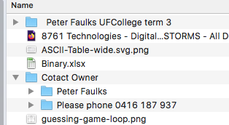
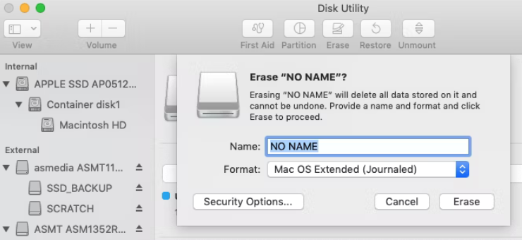
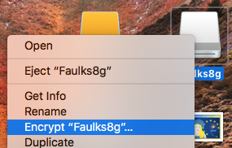
Data Breach (Stolen or lost equipment)
Examples of a breach might include: loss or theft of hard copy notes, USB drives, computers or mobile devices. an unauthorised person gaining access to your laptop, email account or computer network. sending an email with personal data to the wrong person.
STUDENT
I left my USB in the computer lab! (I have
collected a dozen USB’s left in computer labs,
(Always put on your USB a Contact Owner
folder with your mobile number) or use a big key tag.
Windows Encrypt VeraCrypt is the successor of TrueCrypt. It comes as a portable app that runs directly from your flash drive.
Mac: Encrypt your USB You need to format the flash drive with Apple's HFS+ file system. Note that this will delete all files stored on it, so back them up before erasing the USB.
From the Disk Utility app, pick your flash drive and click Erase. In the popup window, specify the file format, Mac OS Extended (Journaled), and select Erase in the bottom right to format the drive. Simply right-click the drive in Finder, select Encrypt, and add a password.
Peter Faulks About Computer Viruses and Hacking Slide 7

Slide 8
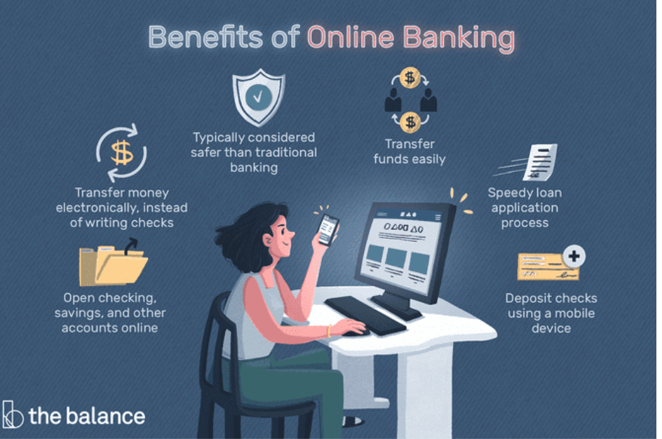
Emotet
The Emotet banking Trojan was first identified by security researchers in 2014. Emotet was originally designed as a banking malware that attempted to sneak onto your computer and steal sensitive and private information. Later versions of the software saw the addition of spamming and malware delivery services—including other banking Trojans.
Emotet uses functionality that helps the software evade detection by some anti-malware products. Emotet uses worm-like capabilities to help spread to other connected computers. This helps in distribution of the malware. This functionality has led the Department of Homeland Security to conclude that Emotet is one of the most costly and destructive malware, affecting government and private sectors, individuals and organizations, and costing upwards of $1M per incident to clean up.
https://www.malwarebytes.com/emotet
Peter Faulks About Computer Viruses and Hacking Slide 8

Slide 9
Keylogger (I built a computer network at a University)
At a University we used a Keylogger to check what students were searching for and if
we got a RED FLAG we could send a message to the student
WARNING YOU ARE CONTRAVEINING UNIVERSITY POLICY
your computer will be turned off in 30 seconds if you continue.
And your Student access may be withdrawn.
What is a keylogger?
A keylogger, sometimes called a keystroke logger or keyboard capture, is a type of surveillance technology used to monitor and record each keystroke on a specific computer. Keylogger software is also available for use on smartphones, such as the Apple iPhone and Android devices.
Keyloggers are often used as a spyware tool by cybercriminals to steal personally identifiable information (PII), login credentials and sensitive enterprise data.
Some uses of keyloggers could be considered ethical or appropriate in varying degrees. Keylogger recorders may also be used by:
Peter Faulks About Computer Viruses and Hacking Slide 9

Slide 10
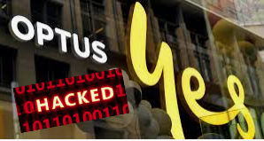
What Is a Hacker?
Hacker – a person who hacks into computers
Hacking is when someone accesses your computer or the data held on it without your permission or knowledge.
Hacking not only happens to huge websites and corporations, but also to individual computers and other personal devices in our homes.
They find out personal information about you, like bank details or account details especially when downloading programs like games software or images and even sound files, etc.
Recently Optus and Medibank have been hacked with a ransom asked
And if not paid, millions of personal details will be sold and distributed to other hackers.
Peter Faulks About Computer Viruses and Hacking Slide 10

Slide 11
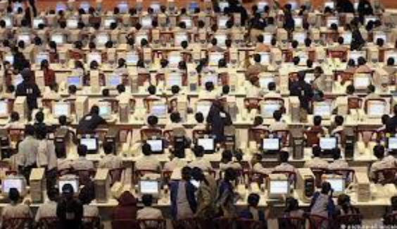
Hacking
Hacking refers to activities that seek to compromise digital devices,
such as computers (Copy or delete all files, data and software on
your computer), and smartphones, tablets and networks.
And while hacking might not always be for malicious purposes,
nowadays most references to hacking, and hackers, characterize
it/them as unlawful activity by cybercriminals—
motivated by financial gain, protest, information gathering (spying)
Getting strange calls about outstanding debt, a car accident or an account with a large company it will be one of these people calling you from????
How do Hackers hide
HTTPS is a universally indispensable protocol for the Web today, and for that reason, port 443 (used by HTTPS/SSL) is very hard to block in a corporate environment. However, DNS over HTTPS (DoH)—a protocol for resolving domains—also uses port 443, and has been abused by malware authors to transmit their command-and-control (C2) commands to infected systems. There are two aspects to this problem. First, by abusing a commonly used protocol like HTTPS or DoH, attackers enjoy the same privacy benefits of end-to-end encrypted channels as legitimate users do. Second, this poses difficulties for network administrators. Blocking DNS in any form itself poses a challenge, but now, given the DNS requests and responses are encrypted over HTTPS, it becomes a nuisance for security professionals to intercept, single out, and analyze the suspicious traffic from many HTTPS requests moving inbound and outbound through the network.
Peter Faulks About Computer Viruses and Hacking Slide 11

Slide 12
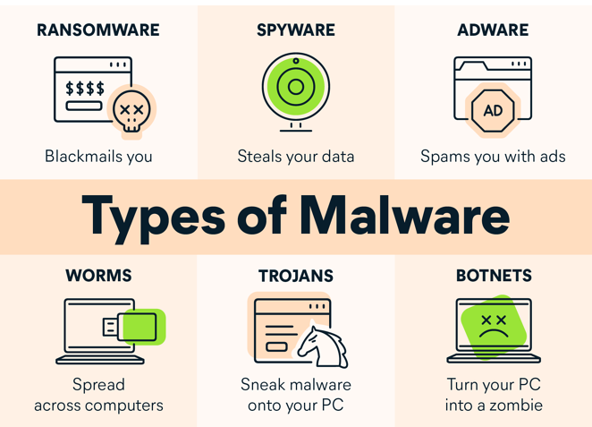
Malware
In most cases, malware is much harder to observe, toiling quietly behind the scenes. Some types are malicious for the sake of spite, wiping important data from the infected machines. With no fraud or theft committed, the hacker’s sole reward is the frustration and setbacks experienced by their victims.
Other instances of malware result in more serious consequences. Machines infected with these types of malware capture the user’s personal or financial information, then forward it to the hacker, who uses it for purposes of financial fraud or identity theft. At this stage, simply removing malware is insufficient to remedy these offenses.
it can steal, encrypt, or delete your data, alter or hijack core computer functions, and spy on your computer activity without your knowledge or permission.
https://www.avast.com/c-malware#symptom-of--malware-infection
Peter Faulks About Computer Viruses and Hacking Slide 12

Slide 13
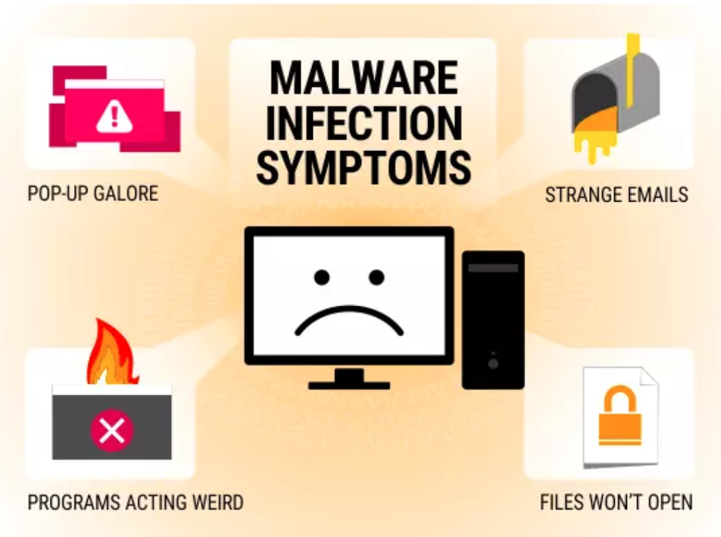
How can you tell that you are infected with Malware
Your device begins running slower than usual. If you’ve noticed a sudden slowdown with no apparent cause, it could be due to a malware infection. As the malware takes over your device’s processing resources, there’s less power
available for everything else. You notice a shortage of available storage space.
Many types of malware will download and install additional files and content onto your device. A sudden decrease in the amount of free storage could be a sign that you’ve picked up some malware.
Pop-ups and unwanted programs appear on your device. This is one of the strongest signs that you’re experiencing a malware infection. If you’re getting slammed with pop-up ads or finding strange new programs on your device, it’s likely that malware is the culprit.
https://enterprise.comodo.com/malware-infection.php
Peter Faulks About Computer Viruses and Hacking Slide 13

Slide 14
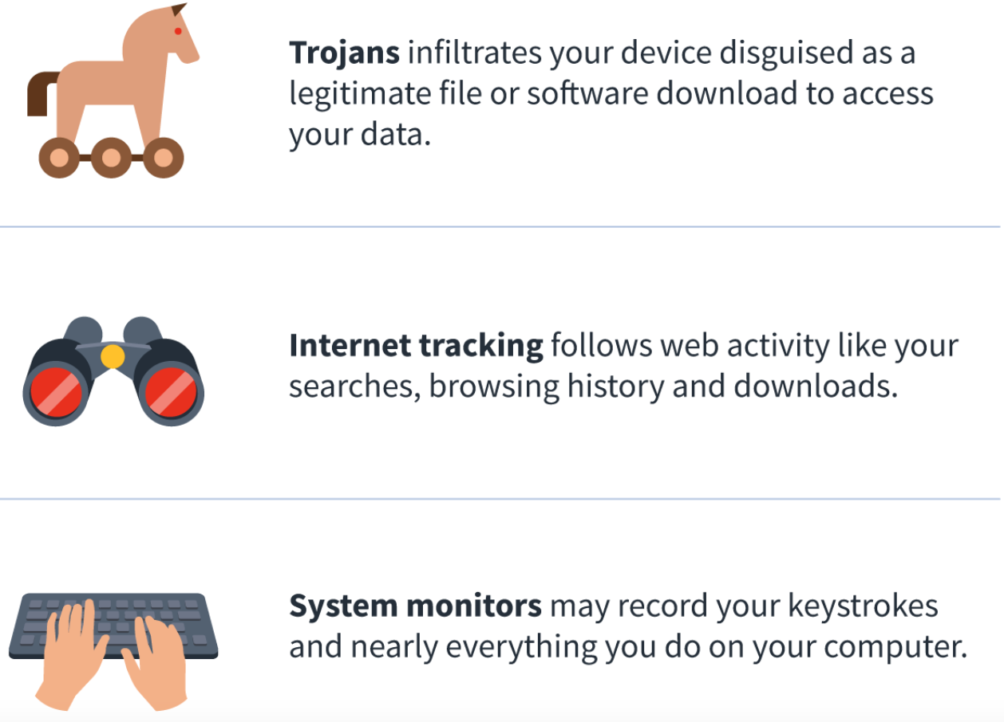
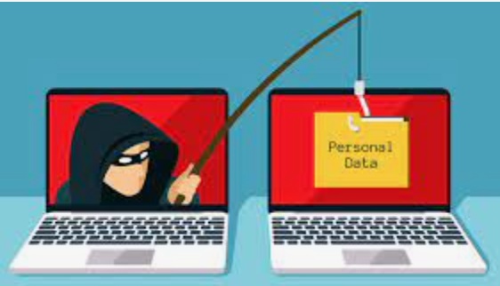
Spyware
Malicious software installed without your knowledge or consent, spyware can come in a few forms.
Spyware collects information about a device or network, then relays this data back to the attacker.
Hackers typically use spyware to monitor a person’s internet activity and harvest personal data, including login credentials, credit card numbers or financial information, for the purposes of fraud or identity theft.
Peter Faulks About Computer Viruses and Hacking Slide 14

Slide 15
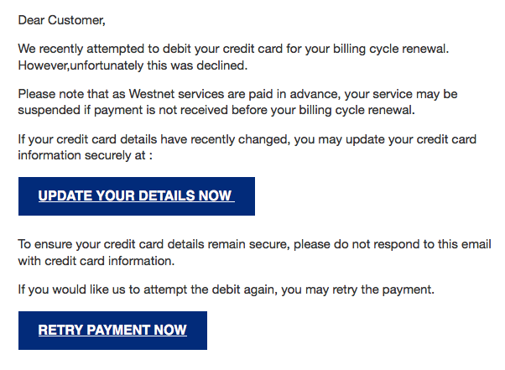
Malware - Phishing
Is the fraudulent practice of sending emails purporting to be from reputable companies in order to induce individuals to reveal personal information, such as passwords and credit card numbers.
"an email that is likely a phishing scam"
Delete files like this and phone the company direct
Never send your bank account details across the internet, talk to your bank
Peter Faulks About Computer Viruses and Hacking Slide 15

Slide 16
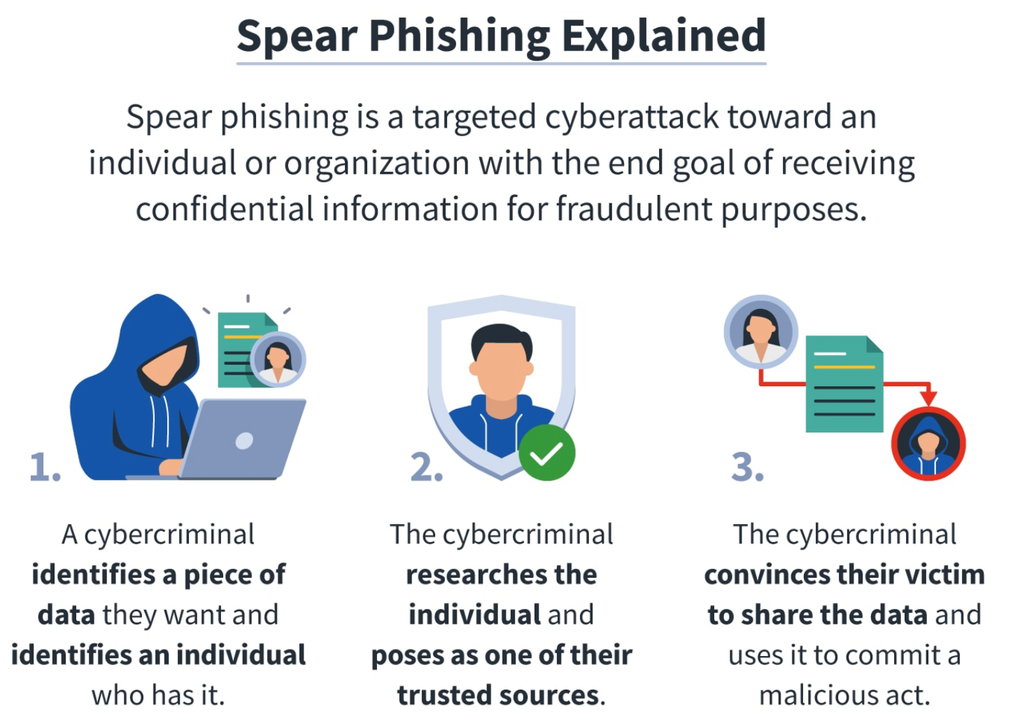
What Are the Different Types of Phishing?
Spear Phishing.
Whaling.
Vishing.
Email Phishing.
Smishing.
Check
Check Spelling look for simple mistakes
Ensure
Ensure HTTP includes S https://
Delete
Delete files like this and phone the company direct
Do not send
Do not send you bank accounts across the internet
Peter Faulks About Computer Viruses and Hacking Slide 16

Slide 17
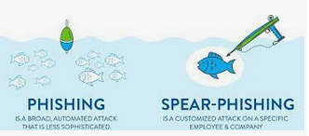
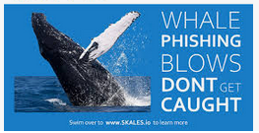
What Are the Different Types of Phishing?
Spear phishing
is a phishing method that targets specific individuals or groups within an organization. It is a potent variant of phishing, a malicious tactic which uses emails, social media, instant messaging, and other platforms to get users to divulge personal information or perform actions that cause network compromise, data loss, or financial loss.
Whale Phishing
The difference between whaling and spear phishing is that whaling exclusively targets high-ranking individuals within an organization, while spear phishing usually goes after a category of individuals with a lower profile.
Peter Faulks About Computer Viruses and Hacking Slide 17

Slide 18
Vishing? Calling you to get your bank details
Often referred to as voice phishing, cyber criminals use savvy social engineering tactics to convince victims to act, giving up private information and access to bank accounts.
Like phishing or smishing, vishing relies on convincing victims that they are doing the right thing by responding to the caller. Often the caller will pretend to be calling from the government, tax department, police, or the victim’s bank.
What is vishing?
During a vishing phone call, a scammer uses social engineering to get you to share personal information and financial details, such as account numbers and passwords. The scammer might say your account has been compromised, claim to represent your bank or law enforcement, or offer to help you install software. Warning: It's probably malware.
Scammers will call with offers that are too good to be true
https://terranovasecurity.com/what-is-vishing/
Peter Faulks About Computer Viruses and Hacking Slide 18

Slide 19
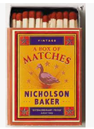
Example of Phishing? Often nothing is sent!
Sample of Phishing scam…
Cigarette Lighter only
$5.00
plus $1.50 postage
Guaranteed
Order NOW!
PO Box 123
Somewhere
Weird Country
No image but this is what people thought they were ordering
Guess what they received?
This is what they sent a
box
of Matches worth 30c
Peter Faulks About Computer Viruses and Hacking Slide 19

Slide 20
Smishing methods
The Delivery Notification
The rise of eCommerce means people are collectively always waiting for a package and checking on the delivery’s progress. Since many websites and delivery companies offer text message updates, many people don’t think twice when they receive a text message with a link for updates.
The Bank/Credit Card Text
Financial institutions are often used as context for smishing attacks because any type of notification about the interruption of funds or unpaid bills is a stressful urgent matter. Most people are bound to click on the link and settle the issue immediately.
The Raffle Win
Most people quickly identify these messages as spam since they don’t enter raffles. But if you did enter a contest recently, these messages can easily lead to malware on your device.
The Password Reset
With the increase in password breaches from several well-known websites, many users have turned to two-factor authentication to protect themselves and their information. This has created a new scam where hackers use SMS to steal passwords.
The Tax Season Scam
Tax season is rife with smishing scams of all types. The most common ones try to convince their victim that they owe money after doing their taxes and direct them to a fraudulent website to pay the required amount.
Peter Faulks About Computer Viruses and Hacking Slide 20

Slide 21
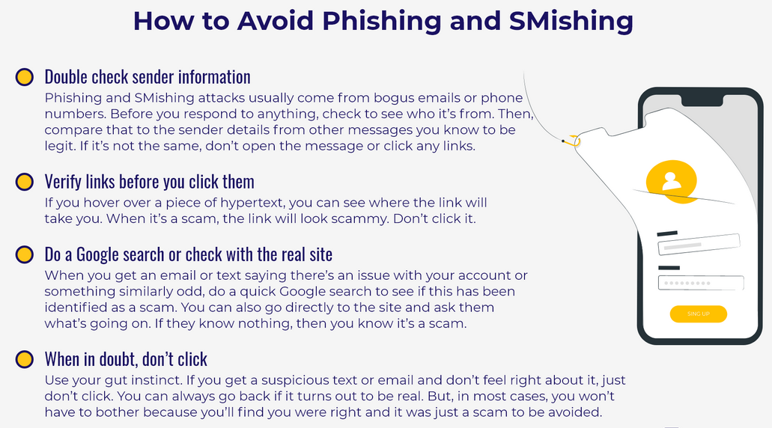
Phishing? And SMishing
SMS
Messages
Check for spelling and grammar mistakes.
Check the email address (does it reply to the company? Or some ad lib name?)
Phone the Bank or company direct.
Only make bank transactions that you trust and for large amounts go to the bank.
https://terranovasecurity.com/smishing-examples/
Peter Faulks About Computer Viruses and Hacking Slide 21

Slide 22
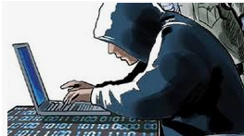
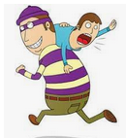
Ransomware
Is the malware version of a kidnapper’s ransom note. It typically works
by locking or denying access to your device and your files until you pay a ransom to the hacker. Any individuals or groups storing critical information on their devices are at risk from the threat of ransomware. Can cost $500 to over $1,000 to recover.
Ransomware is the most confrontational and direct form of malware.
While other types operate undetected, ransomware makes its presence known immediately, demanding payment in exchange for returning access to your
device or files.
Usually someone phones you and tells you that you have a security problem on your computer and ask you to send them your commuter setting DON NOT EVER SEND YOUR IP ADDRESS OR COMPUTER SETTINGS
Ask for a return phone number and tell them you will call back!
Peter Faulks About Computer Viruses and Hacking Slide 22

Slide 23
SPAM (Sales Pest Annoying Me!)
Email spam, also referred to as junk email or simply spam,
is unsolicited messages sent in bulk by email (spamming).
An email box folder filled with spam ...
These emails are obtained through spam-bots: (Crawlers, Spiders) automated programs that find email addresses on the Internet such as in community chat groups, unsecure social networks, and especially multiplayer video games.
These spam-bots then generate large email distribution lists which contain the emails of all the recipients.
Spam emails can be used to hijack your personal information, such as credit card information, and install viruses on your computer.
https://www.dailymotion.com/video/x2hwqlw
https://medium.com/@qasimkhan_3124/how-to-avoid-the-spam-websites-and-emails-d4ff7a04dea2
Peter Faulks About Computer Viruses and Hacking Slide 23

Slide 24
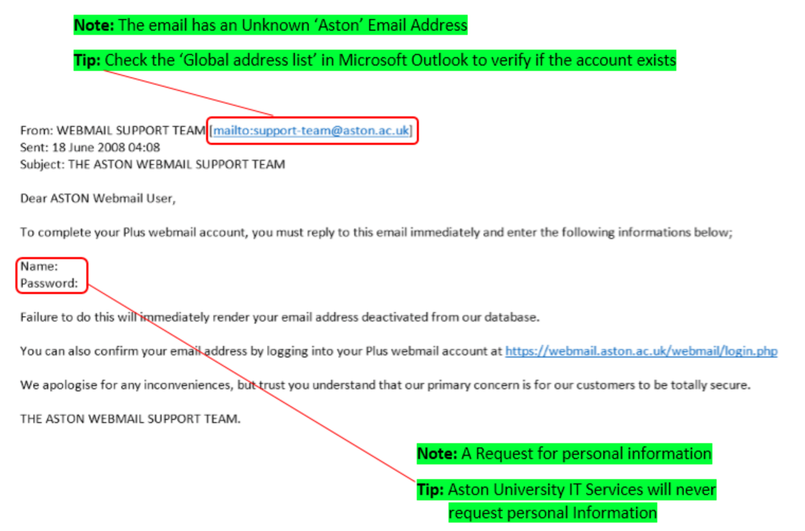
Example e-Mail scam
Sample of Phishing scam…
Copy the email address then paste it into a browser to see if it is genuine
https://www2.aston.ac.uk/ict/services/it-security/spam/sample-spam-emails
Peter Faulks About Computer Viruses and Hacking Slide 24

Slide 25
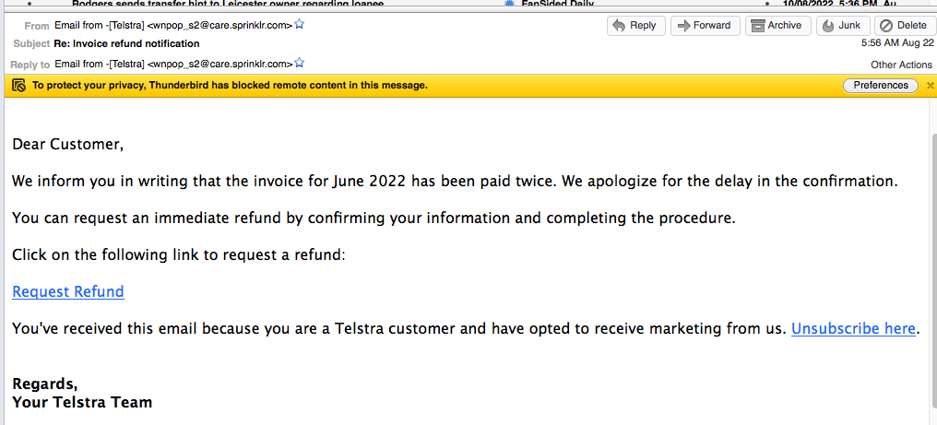
Example e-Mail scam
Copy the email address then paste it into a browser to see if it is genuine
I do not think this is Telstra
it is a scam…
Peter Faulks About Computer Viruses and Hacking Slide 25

Slide 26
Example e-Mail scam Hello Mum…
Ask for special detail like what is her pet’s name, her brother’s middle name, nicknames etc..
Peter Faulks About Computer Viruses and Hacking Slide 26

Slide 27
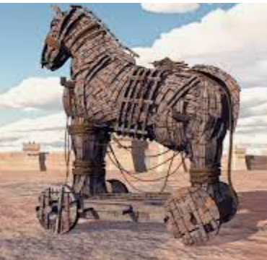
About Trojans. (The Trojan Horse)
According to Quintus Smyrnaeus, Odysseus thought of building a great wooden horse (the horse being the emblem of Troy), hiding an elite force inside, and fooling the Trojans into wheeling the horse into the city as a trophy. Under the leadership of Epeius, the Greeks built the wooden horse in three days.
Trojan malware infiltrates a victim’s device by presenting itself as legitimate software. Once installed, the Trojan activates, sometimes going so far as to download additional malware.
Peter Faulks About Computer Viruses and Hacking Slide 27

Slide 28
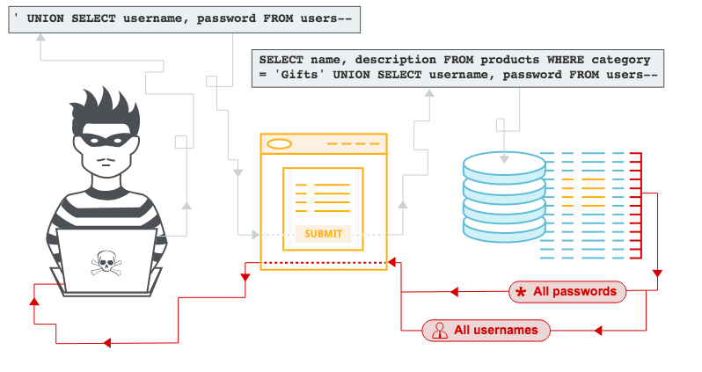
What is SQL injection (SQLi)?
Structured Query Language (SQL) is a standardized programming language that is used to manage relational databases and perform various operations on the data
SQL injection (SQLi) is a
web security vulnerability that allows an attacker to interfere with the queries that an application makes to its database. It generally allows an attacker to view data that they are not normally able to retrieve. This might include data belonging to other users, or any other data that the application itself is able to access. In many cases, an attacker can modify or delete this data, causing persistent changes to the application's content or behavior.
Peter Faulks About Computer Viruses and Hacking Slide 28

Slide 29
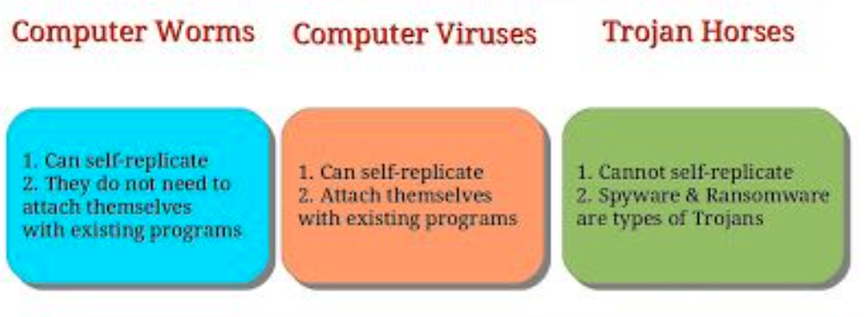
Worms
Worms are designed with one goal in
mind: proliferation. A worm infects a
computer, then replicates itself,
spreading to additional devices while
remaining active on all infected machines.
Some worms act as delivery agents to install additional malware. Other types are designed only to spread, without intentionally causing harm to their host machines – but these still clog up networks with bandwidth demands.
Computer worms could arrive as attachments in spam emails or instant messages (IMs). Once opened, these files could provide a link to a malicious website or automatically download the computer worm. Once it’s installed, the worm silently goes to work and infects the machine without the user’s knowledge.
Worms can modify and delete files, and they can even inject additional malicious software onto a computer.
Peter Faulks About Computer Viruses and Hacking Slide 29

Slide 30
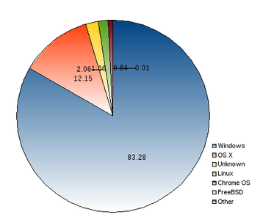
Who is attacking us?
How do we stop BLACK HAT hackers hitting us with Cyber attacks on computers, websites, apps, on computers, phone or lap tops
2013-13 about one third of all computers are affected by Malware but for Mac computers it was only 3% of all Mac Computers
Most computers are Windows (83%) then 12% are
Mac and 5% are Other Computer types Macs have
more in built security
They use a a double data entry Resource Code
and Data Code (both much match)
Mac
Windows
Peter Faulks About Computer Viruses and Hacking Slide 30

Slide 31
Who is attacking us?
How to prevent getting hacked
DO NOT click on suspicious web page links
Do not download images directly from the web (Screen shot them and us the screen capture)
Do not download questionable files (Do Not download and install direct from the web) These will probably be Malware Trojan viruses
These will usually appear as a POP UP like install FLASH or Install Clean up applications.
Have good Antivirus protection (Better anti Malware)
Use a VNP
Peter Faulks About Computer Viruses and Hacking Slide 31

Slide 32
Computer Protection
Microsoft Windows computers since Windows 10 have had a built-in antivirus
This is Microsoft Defender
The early versions were very poor but after 2020 this has improved substantially so as long as you update your security setting regularly you will have some protection
Apple Macs also have built in Antivirus and more protection
Peter Faulks About Computer Viruses and Hacking Slide 32

Slide 33
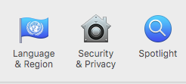
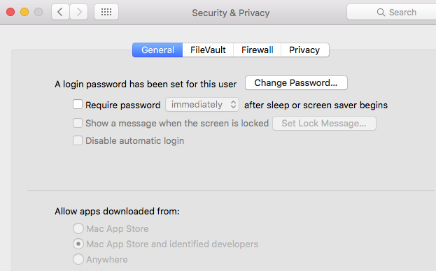
Apple has built in Antivirus
Apple have some built in Malware protection (you can’t see it but it is there) The first is Gatekeeper in security settings
Allow Apps only from the Apple Store that have been tested and are secure
Peter Faulks About Computer Viruses and Hacking Slide 33

Slide 34
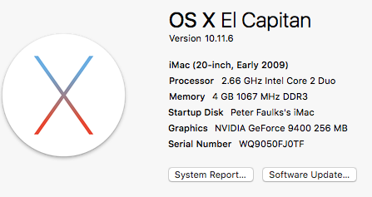
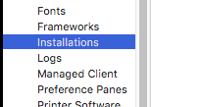
Apple has built in Antivirus
Apple have some built in Malware protection (you can’t see it but it is there) The next is X Protect open About this Mac
Allow Apps only from Store
Peter Faulks About Computer Viruses and Hacking Slide 34

Slide 35
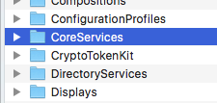
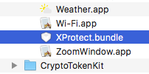
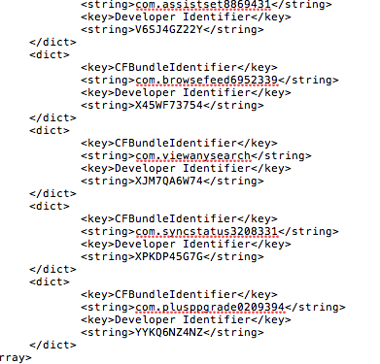
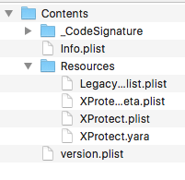
Apple has built in Antivirus
Look to see if X Protect has spotted any cyber attacks from your hard drive
Right Mouse Click
You can look at your System and follow this path it will show you if X-Protect has
Found any viruses.
NOTE: My computer will not show any because I do not have any Malware on my computer
Peter Faulks About Computer Viruses and Hacking Slide 35

Slide 36
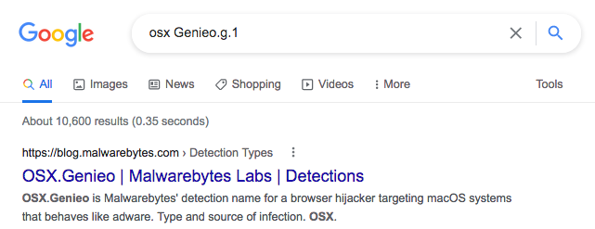
Apple has built in Antivirus 2
Look to see if X Protect has spotted any cyber attacks from your hard drive
A virus like Genio.g.1 might be seen so we can see what it is
X Protect would have removed this
Peter Faulks About Computer Viruses and Hacking Slide 36

Slide 37
Apple has built in Antivirus 3
Apple have some built in Malware protection (you can’t see it but it is there) The last is MRT About this Mac
MRT Malware Removal Tool
It runs in the background
Allow Apps only from Store
Ensure your system is updated
https://www.youtube.com/watch?v=xp_VaiqQFmI
Peter Faulks About Computer Viruses and Hacking Slide 37

Slide 38
Viruses & Hacking
The End
Peter Faulks About Computer Viruses and Hacking Slide 38

